Slide 1
ART National Conference Satisfaction Questionnaire 2025
Survey closed on 2nd December 2025.
14 responses received.

Slide 2
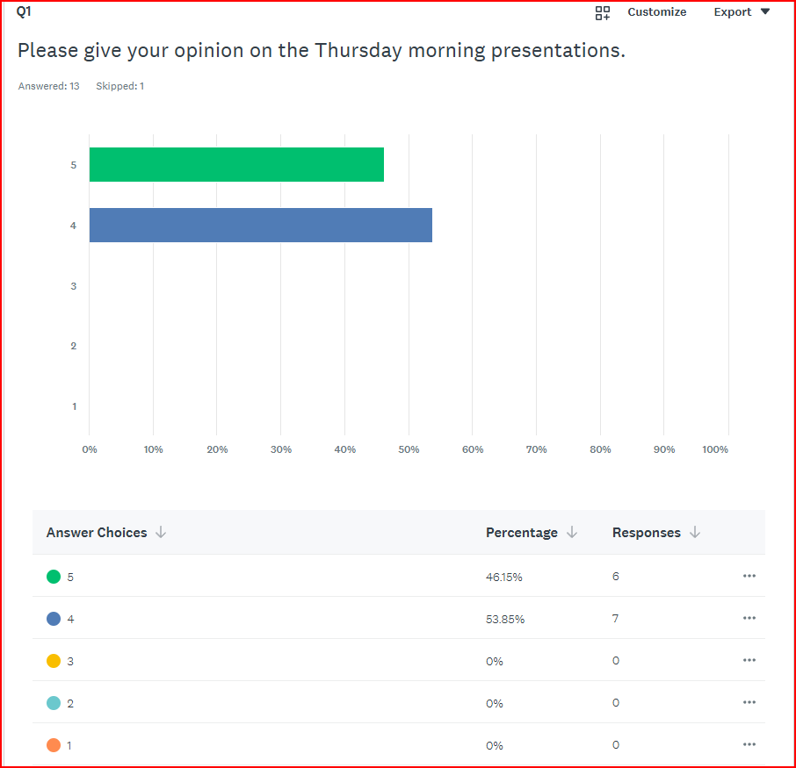

Slide 3
Q1
Missed having a workshop session
Great talks, and plenty of opportunity to engage with speakers
overran by 30 minutes
Dr Whitfield's passion on educating the workforce was impressive. as an organisation, we could register ourselves to attend different job exhibitions to attract the younger generation. We could have a stand and the apprenticeship programme she discussed could be given out as handouts so that the would-be apprentice know the pathway to follow.
Fantastic

Slide 4
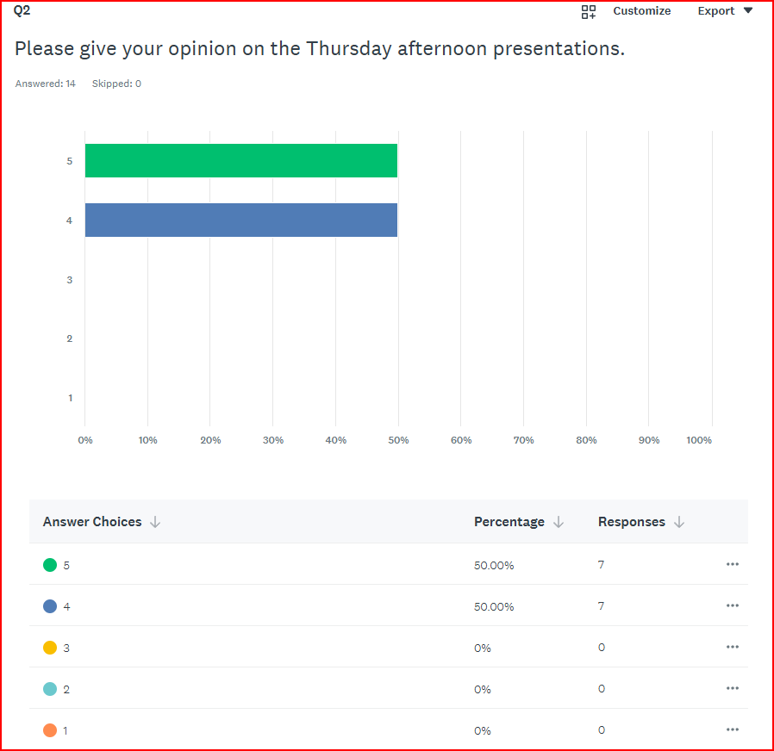

Slide 5
Q2
another great session...
If we all adopt the sustainability initiatives that were outlined, we can be a force for good within the NHS. Learning about water and microplastics, was very useful, but as Peter said, the NHS is very disjointed. Currently at Barts, there is a professor studying a PhD and analysing the amount of microplastics going into the patient, if you put him in touch with Nicholas Hoenich, maybe they can work together. shoaib.saadat@nhs.net

Slide 6
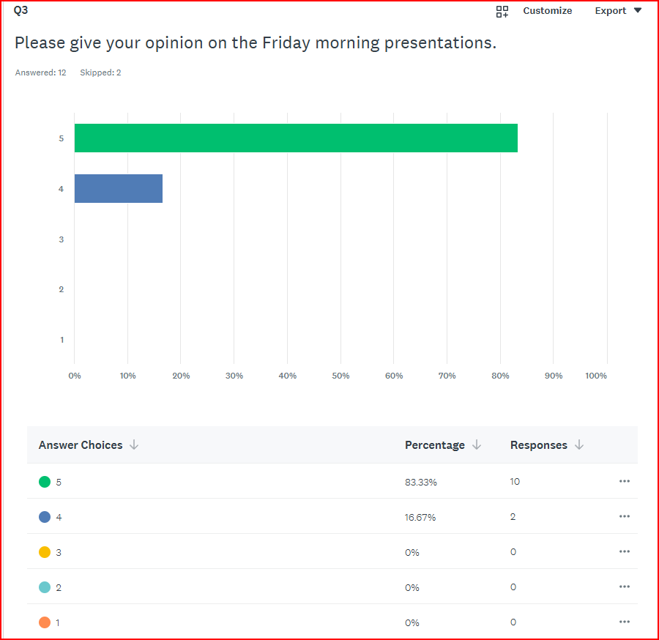

Slide 7
Q3
I wasn’t able to attend.
Baring feeling slightly 'less with it' both talks were great. So refreshing to see someone stand up, be counted, and displaying a desire to learn from mistakes
learned a great deal with EST presentation
Where possible and to safeguard Renal Techs, we need to work together and share SOPs, maybe compile a list of all SOP's for what we do and share this on the forum. We could adapt them for our individual Trusts, by sharing good practice.

Slide 8
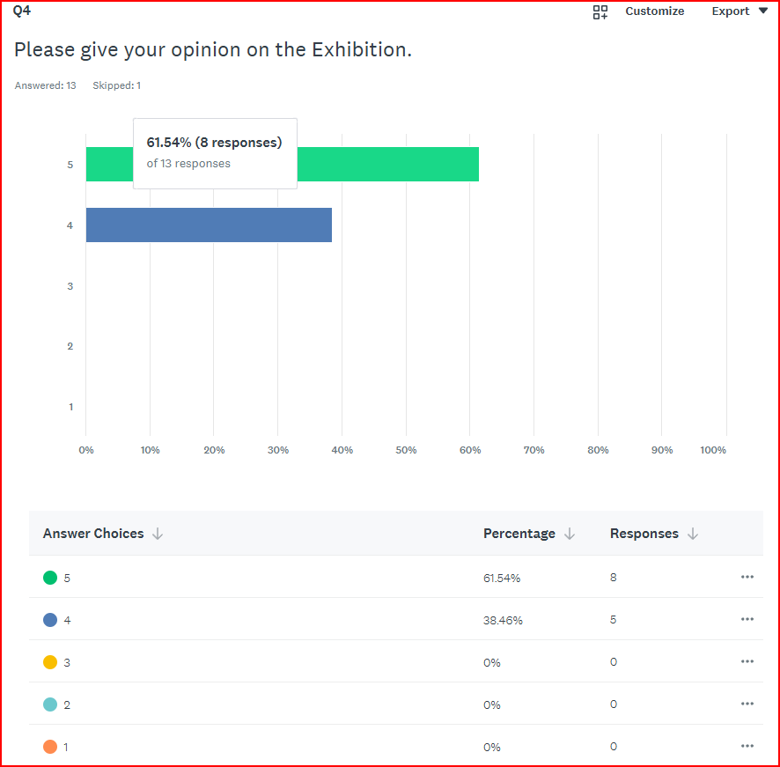

Slide 9
Q4
All good once again. So great that there are many manufacturers making the experience so much better
very engaging, we need to work together to make things better.

Slide 10
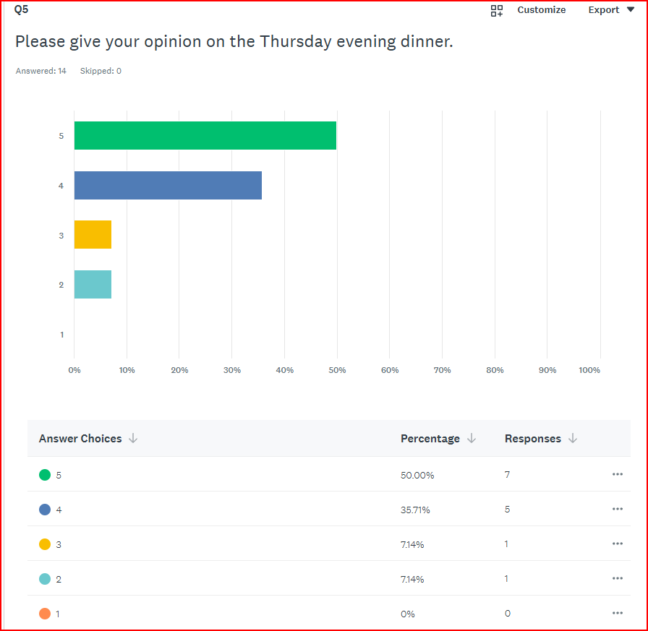

Slide 11
Q5
Could have been an inclusive dinner, not a standard choice
I thought the food was really tasty and quickly served. Could have maybe done with some more portions of veg on the table.
Enjoyed the evening. So nice to be awarded the certificate in front of my peers and colleagues
Apple pie and waiter/ess very poor
Enjoyable, and relaxed.

Slide 12
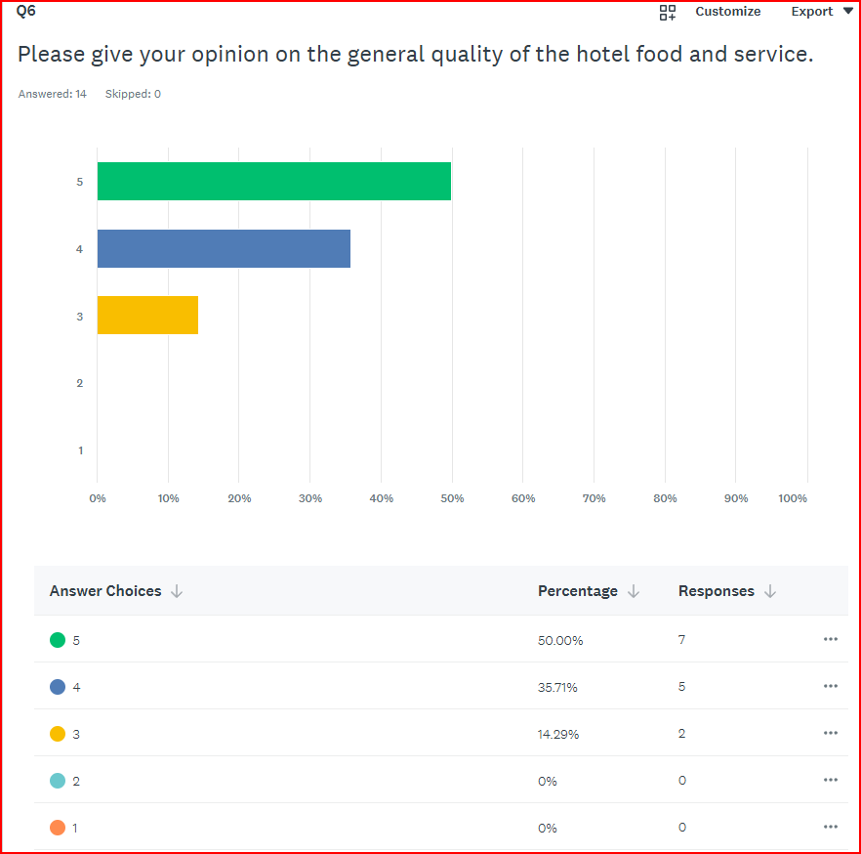

Slide 13
Q6
Food and staff excellent
No option to drink in comfortable setting after the meal
wonderful food. Well catered for
I found the service didn't meet my expectation in several areas but particularly in bars were closed with customers still wanting to use them, the main bar was closed at 10.30 just was we were going out of the dinner for a quiet drink. I shout the buffet lunch was dreadful.
Very good ambiance, food selection and quality

Slide 14
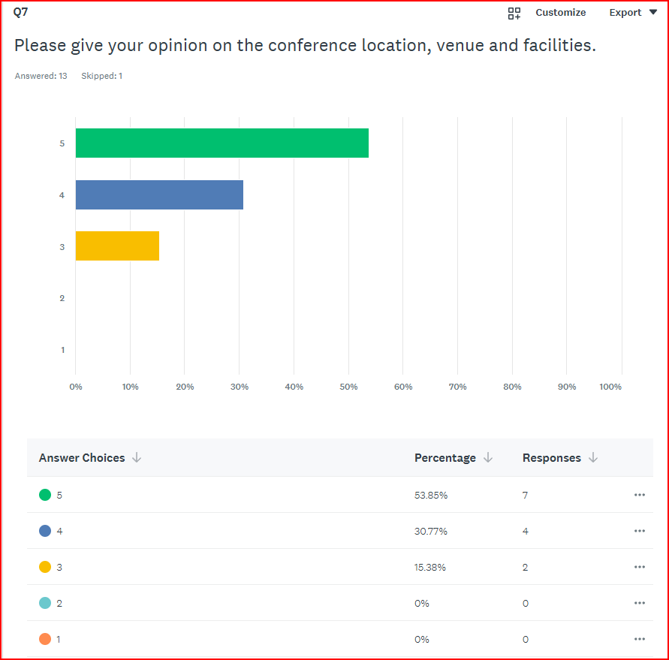

Slide 15
Q7
Very good!
Location good, venue and facilities good, but not overly accommodating of guests given how many people were in attendance
Only scoring this a three, not because it hasn't got many facilities but because I didn't use them,
long way
Excellent

Slide 16
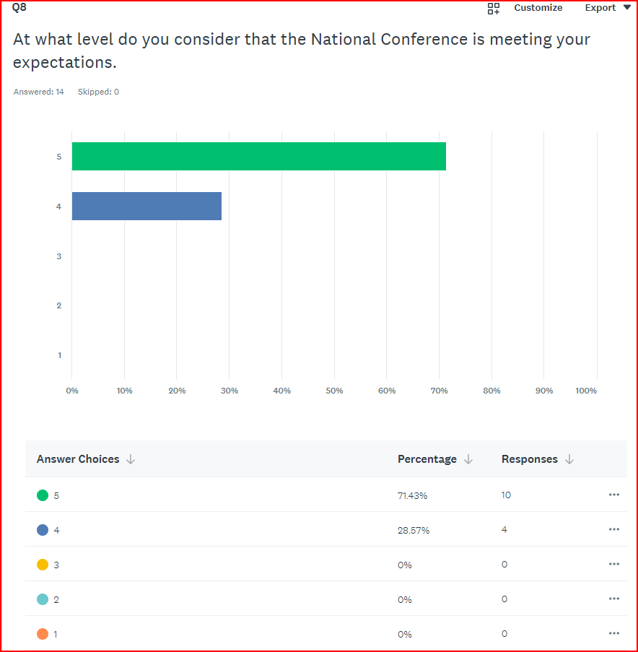

Slide 17
Q8
provides an opportunity to network, learn, share and develop the whole renal technical community
Additional Technical Presentations similar to Friday morning's would be most welcomed.
Informative, Renal techs very open to information sharing and generally a good bunch of people, genuine

Slide 18
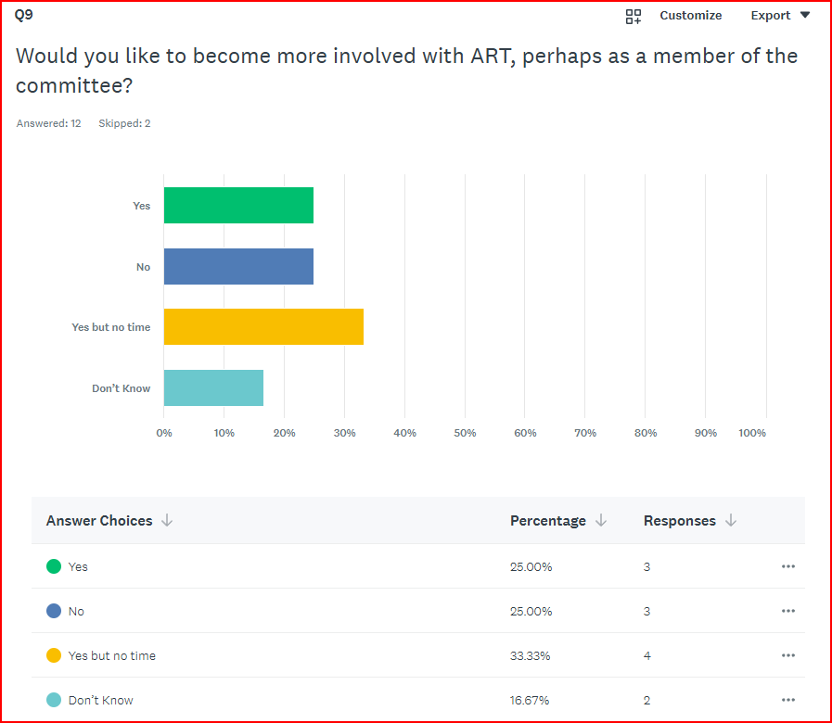

Slide 19
Q9
Happy to put my name forward, especially as there will be an exodus in the not to distant future of senior, experienced technicians
Short time working group inclusion

Slide 20
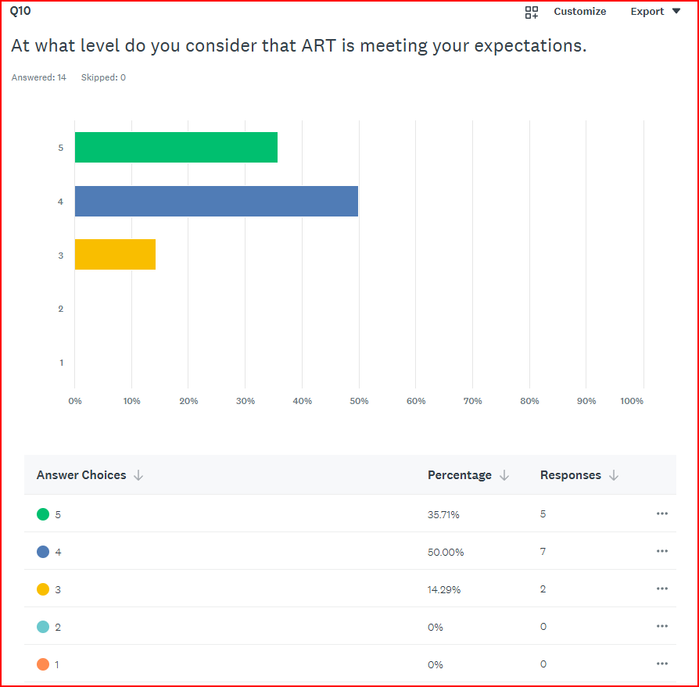

Slide 21
Q10
Giving it a 4... room for improvement, and probably would like more information disseminated throughout the year
More regular communication and summary of changes to Standards would be welcomed.
website needs sprucing up and updated

